Slide 1
Fetal Growth and Wellbeing
Dr.Tiran Dias
MD (Obs & Gyn), MRCOG (UK)
MD (London)
Advanced Diploma in Fetal Medicine (UK)
ATSM-Fetal Medicine (RCOG-UK)
Senior Lecturer
Consultant Obstetrician and Gynaecologist
NCTH Ragama

Slide 2
Fetal Growth
Is dynamic and depends on
Maternal cardiac performance
Utero-placental blood supply
Genetic growth potential

Slide 3
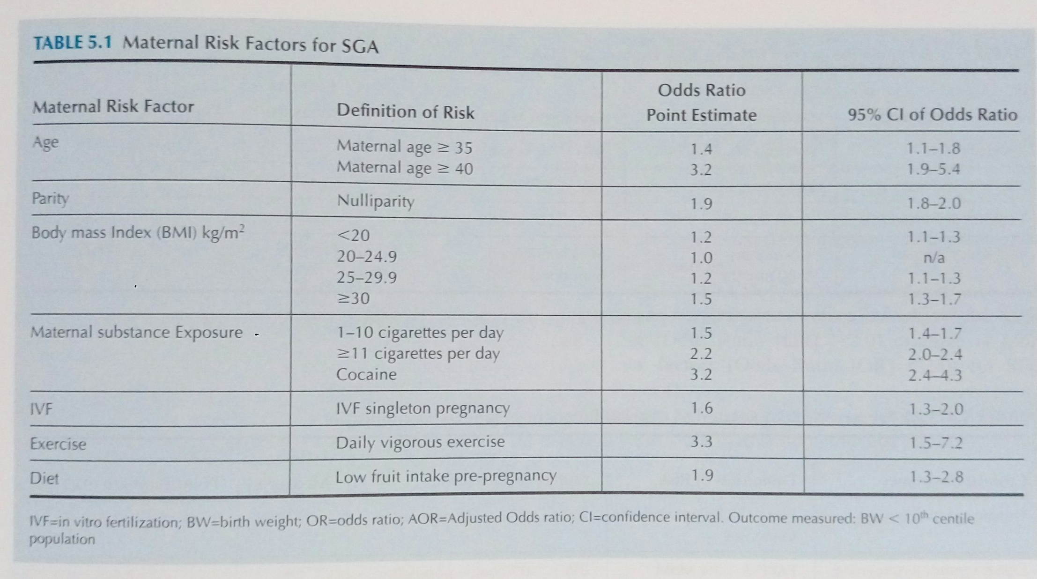
Risk factors

Slide 4
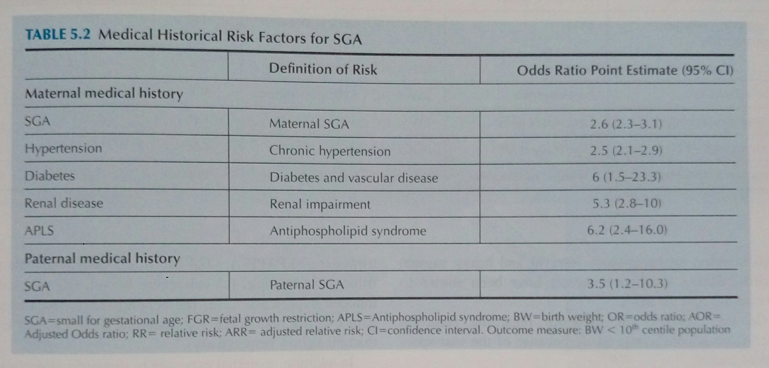

Slide 5
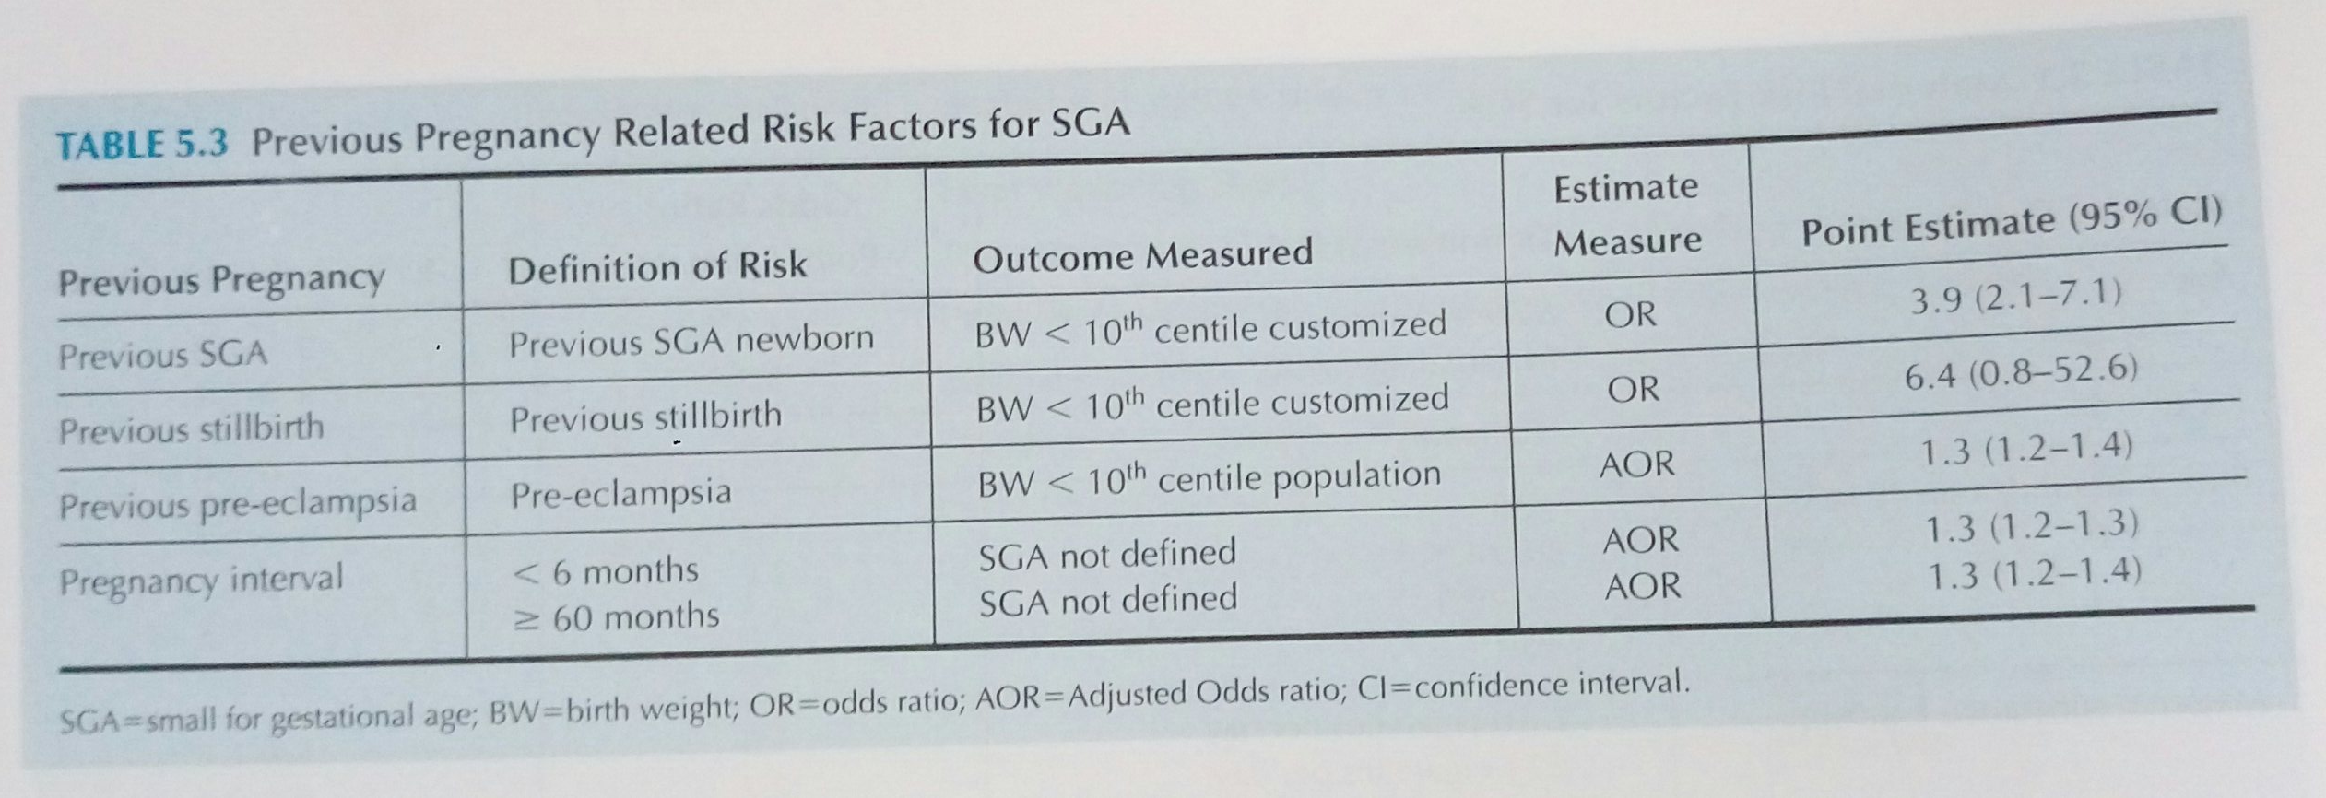

Slide 6
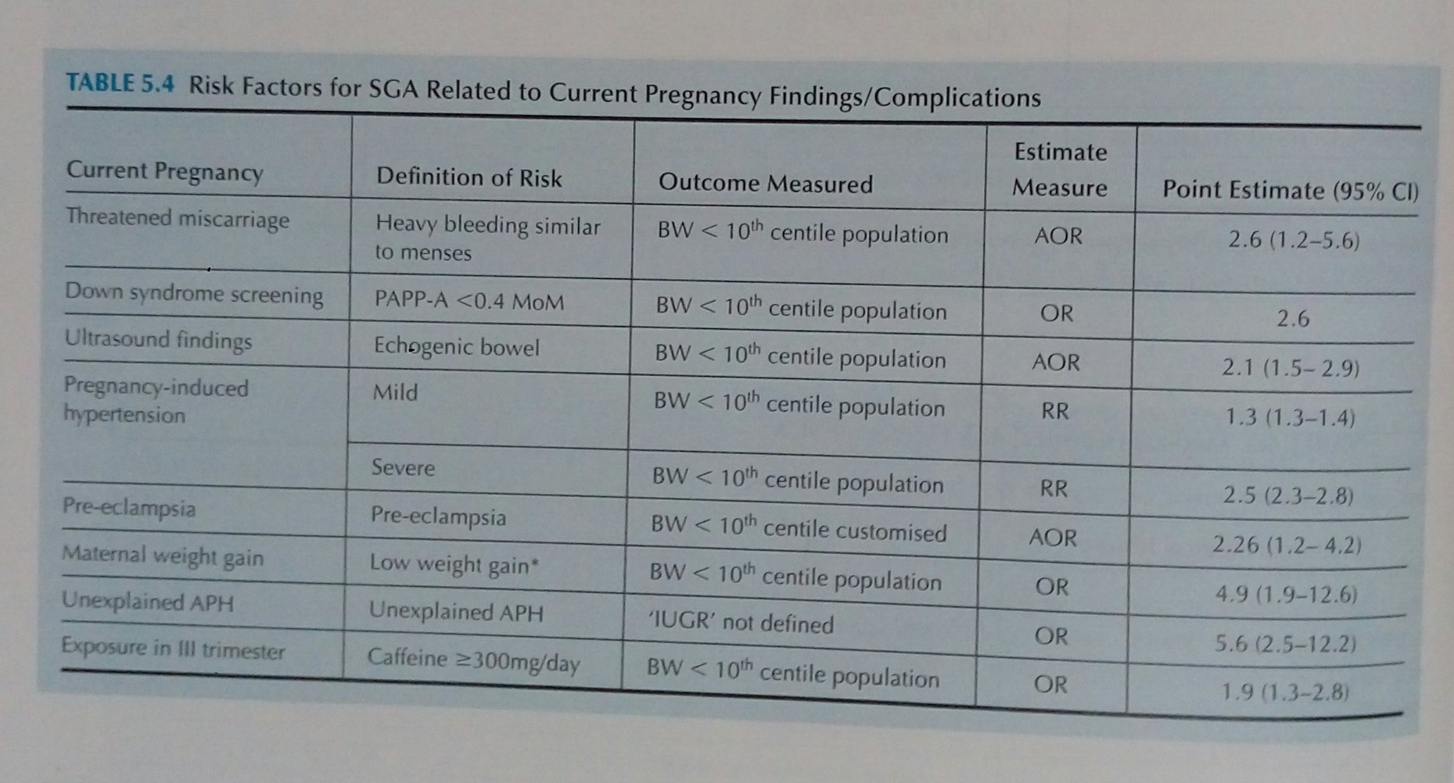

Slide 7
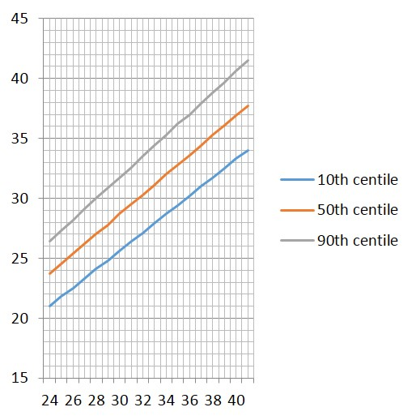
Fetal Growth Assessment
SFH measurement (after 24 weeks)
Mothers should be in a supine position on a firm surface, with an empty bladder
SFH is measured from the fundus (variable point) to the symphysis pubis (fixed point) along the longitudinal axis of the uterus with the cm values hidden from the operator.

Slide 8
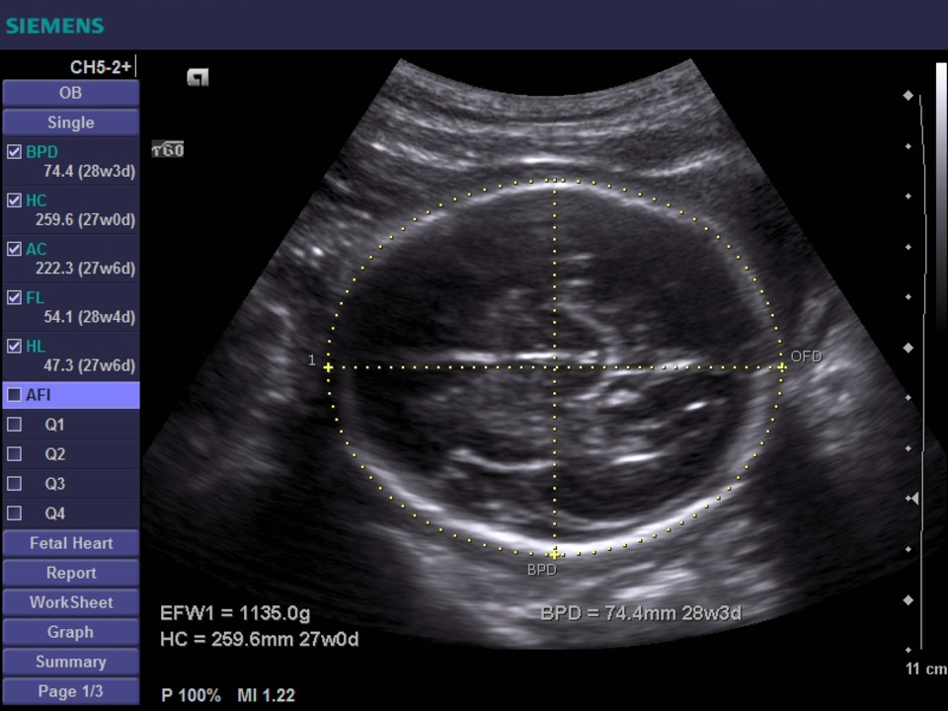
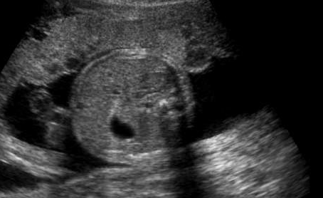
Fetal Growth Assessment
Ultrasound Fetal Biometry
Fetal Mead measurements (Biparietal diameter-BPD, Head circumference –HC)
Fetal Abdominal Circumference
Fetal femur length

Slide 9
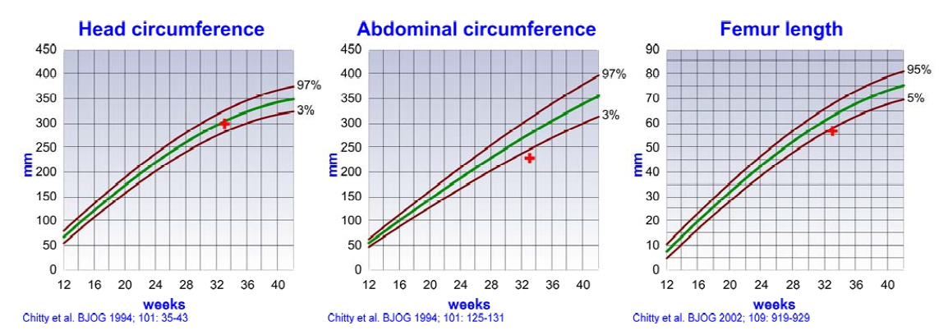
Fetal Growth Assessment

Slide 10
Fetal Wellbeing
To establish whether baby is healthy or Sick
Which test?

Slide 11
Fetal Wellbeing Assessment
Fetal movement counting
Count to 10 movements in a fixed time frame (Originally for12 hour, Cardiff method by Pearson and Weaver)
Modified protocols include
count to 6 hours Liston et al
count to 2 hours Moore at al

Slide 12
Fetal movement counting
Stillbirth rate unchanged
Greater use of resources
More frequent admission
Increased elective delivery
Randomised studies
Routine vs. standard
Neldham et al 1983 n = 3,111
Grant et al. 1989 n = 60,953
Routine formal fetal movement counting should not be offered (NICE 2010)

Slide 13
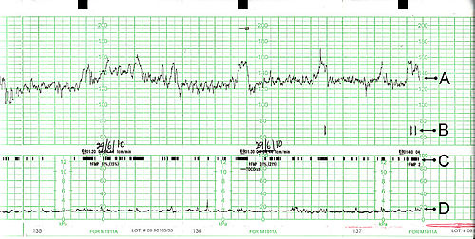
Fetal Wellbeing Assessment
Non-stress test (CTG)

Slide 14
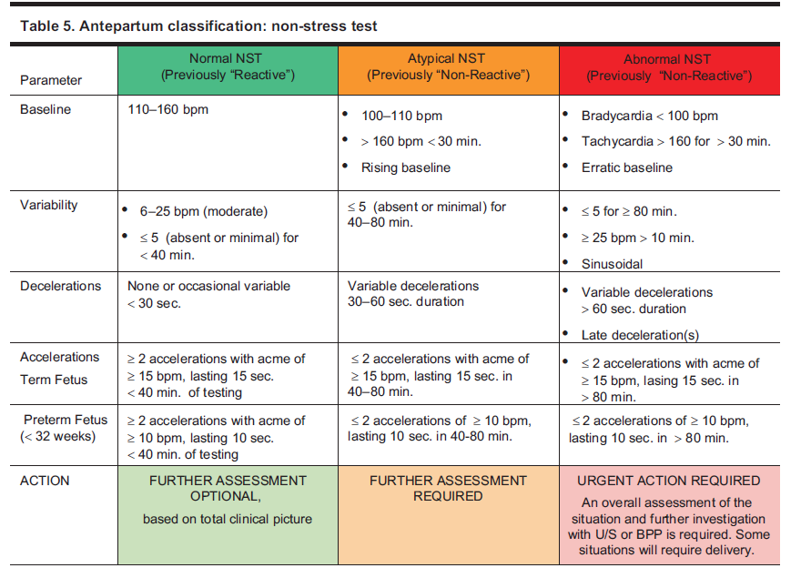

Slide 15
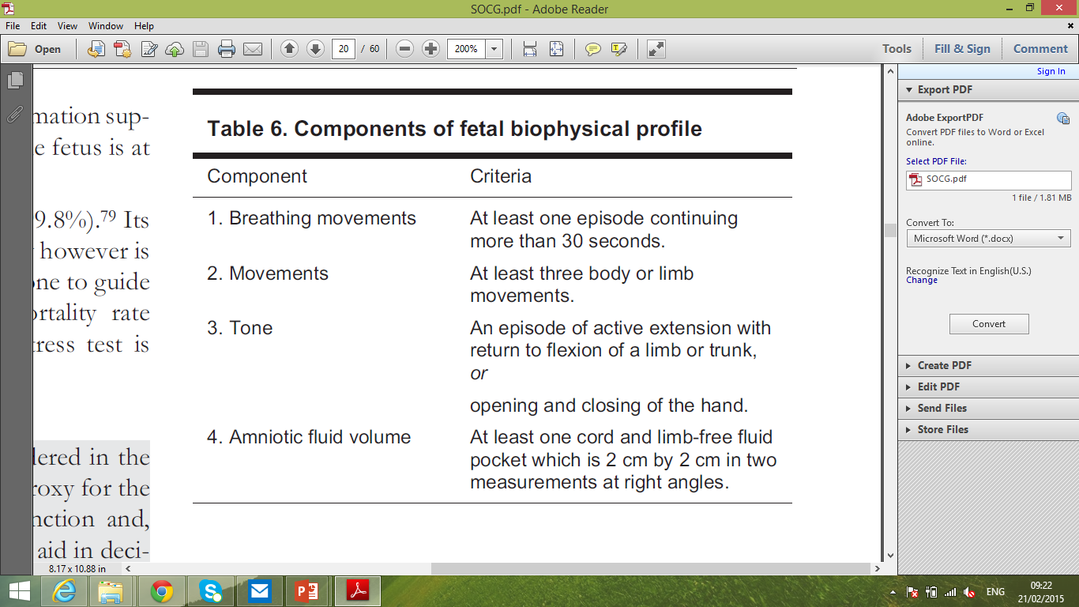
Fetal Wellbeing Assessment
Biophysical profile (BPP)

Slide 16
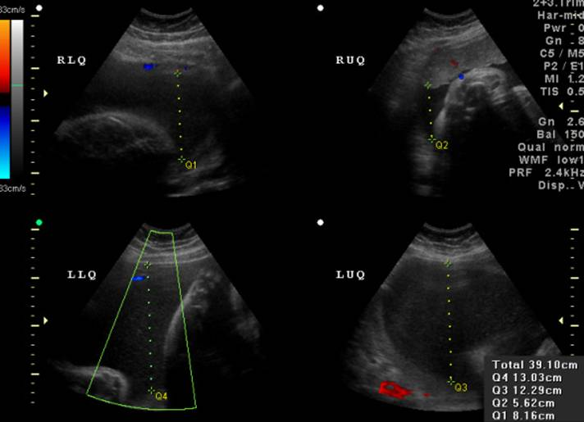
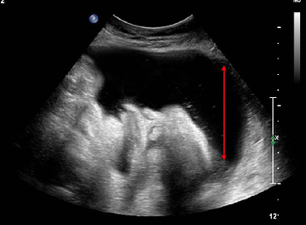
Fetal Wellbeing Assessment
Amniotic fluid volume
AFI
DVLP

Slide 17
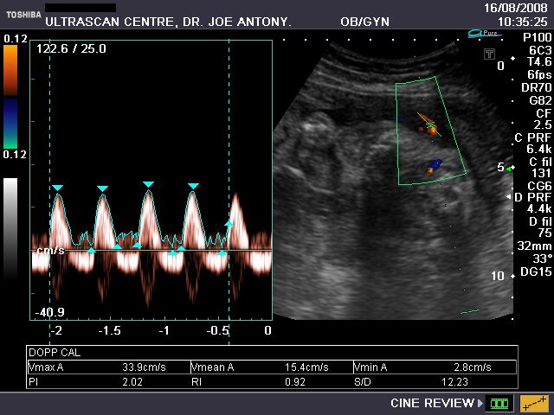
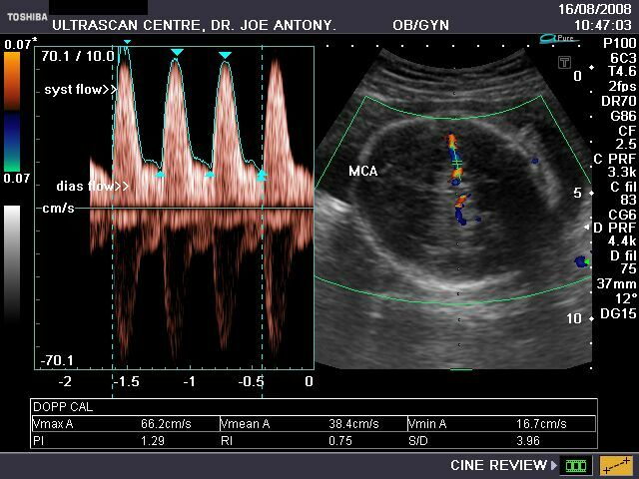
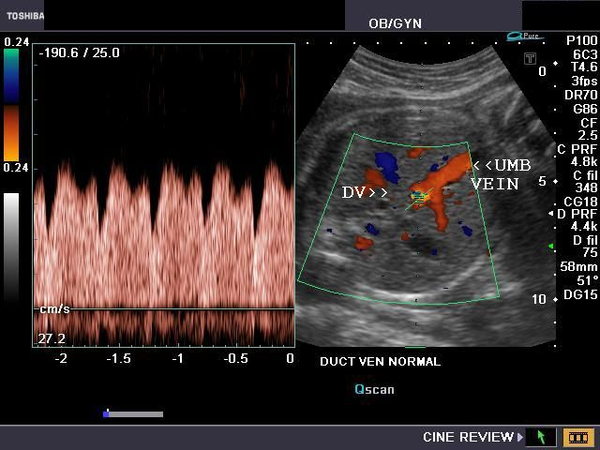
Fetal Wellbeing Assessment
Fetal Arterial and Venous Doppler studies
Umbilical artery Doppler
Middle cerebral artery Doppler
Ductus venosus Doppler

Slide 18
Antenatal Fetal Surveillance
Fetal umbilical artery Doppler in High risk pregnancy
Randomised studies
10 studies
approximately 8,000 women
37/3472 Doppler vs 74/3559 Controls
OR 0.51 (Perinatal mortality)
CI 0.34 to 0.76

Slide 19
Quiz
Wrong dates
Normal small
Starved small
Abnormal small
Ultrasound Fetal Biometry
Doppler Studies
Anomaly scan - Karyotyping
Notes:
2

Slide 20
Quiz 1
No fetal defects
Normal amniotic fluid
Normal fetal activity
Wrong dates
Serial measurements parallel to the normal
Normal small
Normal small
Serial measurements
falling away from normal
Wrong dates
Notes:
2

Slide 21
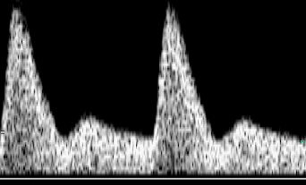
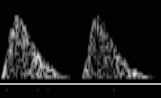
Quiz 2
Asymmetrical growth
Serial measurements
falling away from normal
No fetal defects
Reduced amniotic fluid
Reduced fetal activity
Starved small (FGR)
Doppler
Abnormal uterine & umbilical flow
Middle cerebral PI decreased
Notes:
2

Slide 22
Quiz 3
Fetal defects
Markers for trisomy 18 or triploidy
Markers of fetal infection
Growth: symmetrical or asymmetrical
Serial measurements falling away from normal (AC > FL > HC > TCD)
Amniotic fluid volume & fetal activity
normal or increased or decreased
Abnormal small
Doppler
Uterine arteries: normal
Umbilical arteries: normal or abnormal
Middle cerebral artery: normal
Notes:
2

